Slide 1
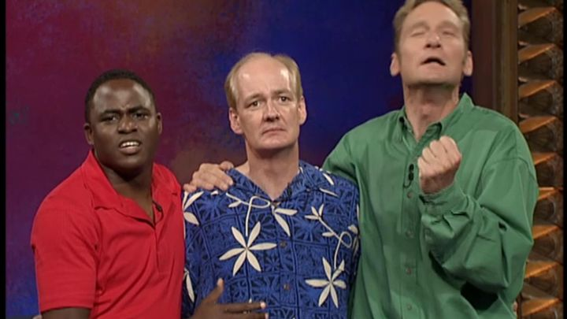
Improvisation: Not Just a Hail Mary
Notes:
Introductions. Improvisation can make you a better communicator, educator and trainer.

Slide 2
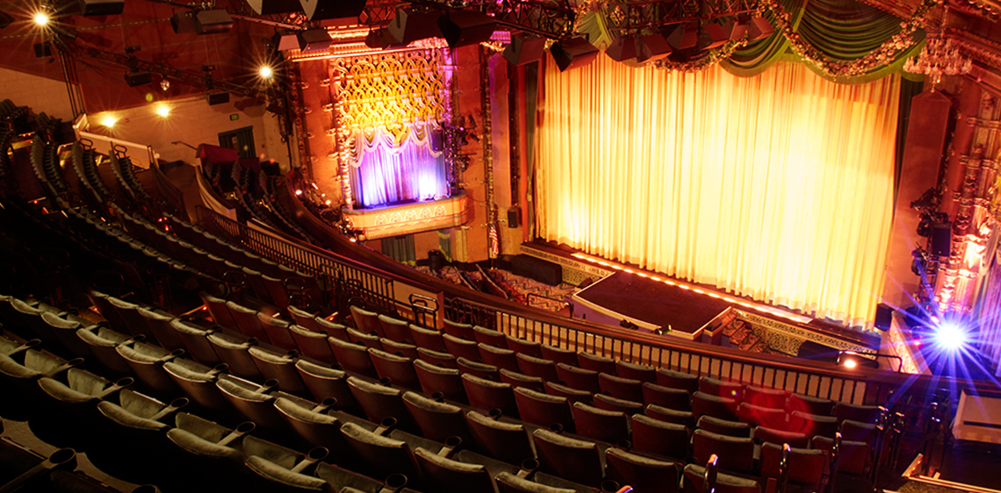
Notes:
Improvisation, in the performing arts is a very spontaneous performance without specific or scripted preparation. People improvise all the time.

Slide 3
Notes:
Improv can be uncomfortable, but the more you practice it the easier it becomes. Improv can make you a better listener, it can make you better at non verbal communication/body language, it can make you more creative and build your critical thinking.

Slide 4
Notes:
There are rules of improv, and depending on who you talk to there can be between 4 – 10 rules. I will be chatting about 6 rules of improv.

Slide 5
Notes:
Say Yes, and. Saying yes means that you are engaging in what is being offered to you. Saying no, or approaching an offer in a negative manner will shut down the exchange.
If you think of ‘say yes’ in the context of communication – if you always shut down someone's suggestions, or attempts at conversation you are going to kill the conversation. Saying yes and saying yes and, does not have to be literal. Just by responding in a positive manner and building off of that is what is important.
In the context of education, saying yes and saying yes and encourages your participants to engage with you further. If you ask a question to a group [providing up an offer] and they answer the question with their ideas [accepting your offer] you want to follow up with a ‘yes, and’ [accepting their offer]. This can look like an actual ‘yes, and what does that tell us’ or a ‘very good idea, what made you think of that?’. Can you think of non literal examples of yes, and that you use?

Slide 6
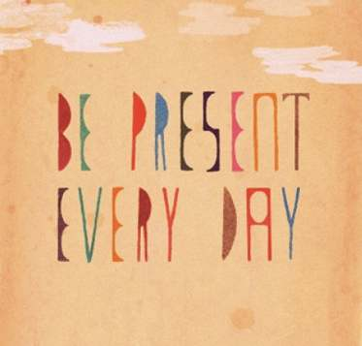
Notes:
Be Present. Improv is unscripted, you don’t know what is going to happen next but you have to tell a story. Improv requires you to be present, if you are thinking about what just happened or focusing on what might happen you will miss what is currently happening. Improv requires you to focus, listen and look.
Practicing improv games or using improv techniques will help you flex or build you listening skills and your nonverbal communication skills. When you are delivering a program, giving a tour, training or exploring your site with visitors, you have no idea what could happen next. Even if you have a program plan or a script, your visitors don’t know what that plan is or what the script is, they don’t know what is supposed to happen next. Being present in what is happening can help you converse with your group better and guide that conversation/program/tour/exploration.

Slide 7
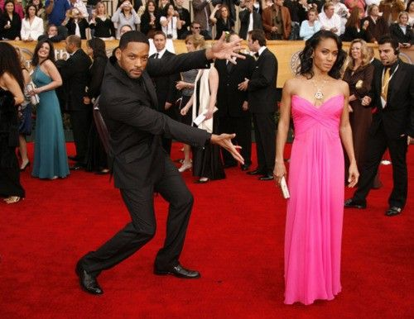
Notes:
Make your partner look good. Improv isn't just about you – its not stand up where you are slaying the audience with your observations and wit! Improv is about the scene and that means its about the audiences experience with the entire group not just one person. Making your partner look good can come back to Yes, And but it also means entering into an exchange by being present and being enthusiastic. It also means being aware of what you are doing and how you are responding. Contradictions harm improv and they can make your partner look bad – this loops back into yes, and.
What would making your partner look good look like to you in regards to communication/informal education?

Slide 8
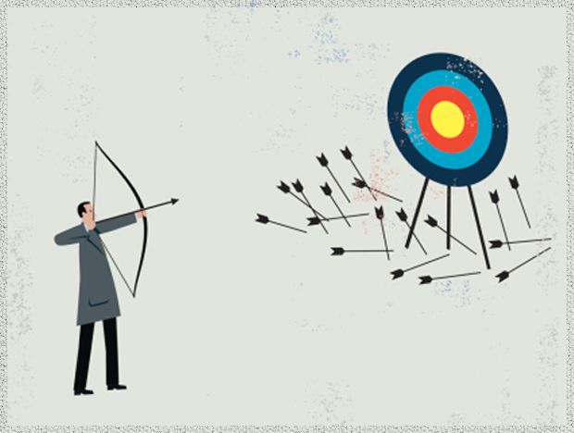
Notes:
Embrace failure. Improv is all about failure because that’s how you grow. Failing provides the opportunity to explore and try again. Learning to fail is hard, learning to fail in front of people is even harder. But the nice thing, is that everybody fails. And to model failing in a good way can help others. Knowing how to accept as a communicator that you have failed makes you a better communicator. Being able to say “oh wait, maybe I miss remembered” or being able to say “you’re right, I'm wrong” or “I don’t actually know”.

Slide 9
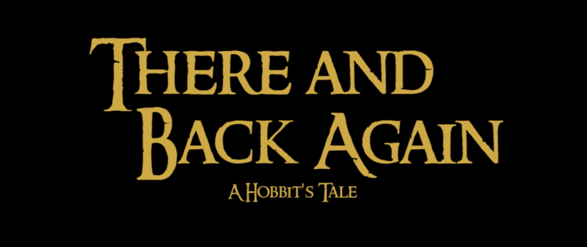
Notes:
Tell a story/take a journey. Improv is storytelling, every story has a beginning, a middle and an end. In improv, your not just telling the story yourself, you are telling the story with your team mates, with the people on the stage. It’s a collaboration.
Communicating is the same way, you are working together and exchanging together to get to an end point.

Slide 10
Notes:
Make statements. Improv and conversations cant all just be questions – that’s an interrogation. You have to make statements to add the details. To share your story and to enrich the conversation. Statements take the pressure off your partner and making statements also gives your actions conviction.

Slide 11
Inquiry & Improv
Notes:
Inquiry and Improv. Can improv help with the new BC Curriculum?

Slide 12
Inquiry = Improv
Notes:
Yes because improv is inquiry. We know that people learn better (with deeper levels of understanding) when they are engaged. That is why inquiry based learning has risen to the forefront of education, because it is learner focused and learner driven. But learner driven means there is no script, you can have a general sense of where things might go but you will never know for sure. Inquiry involves open ended questions that allow for many responses and then scaffolding information on top to deepen the conversation.
In an exchange the learner will make an ‘offer’ and the staff can accept that offer and build of off it “Yes, and’. The rules of improv support inquiry based learning. It can all just be questions and scaffolding, sometimes you need to make statements as well and at its core – improv is audience driven, just as inquiry is learner driven. This is something our staff have struggled with, the concept of inquiry being question driven and unsure of how to guide that conversation. Making statements is how you can guide that conversation while still practicing inquiry based learning.

Slide 13
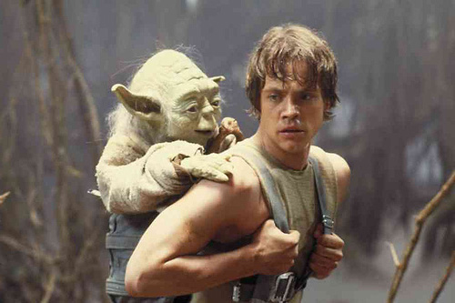
Notes:
Improv and training.
Improv skills teach you how to work together, how to operate under pressure, how to be a team and trust your team, how to communicate and how to fail and learn from your mistakes. Use the rules of improv to frame how you train your staff and use the rules as tools they can use when they interact with the public.
Learning improv skills and practicing improv can make you a better trainer, it gives you the skills and comfort to respond to the unexpected and to move forward together.
Saying Yes
Embracing Failure

Slide 14
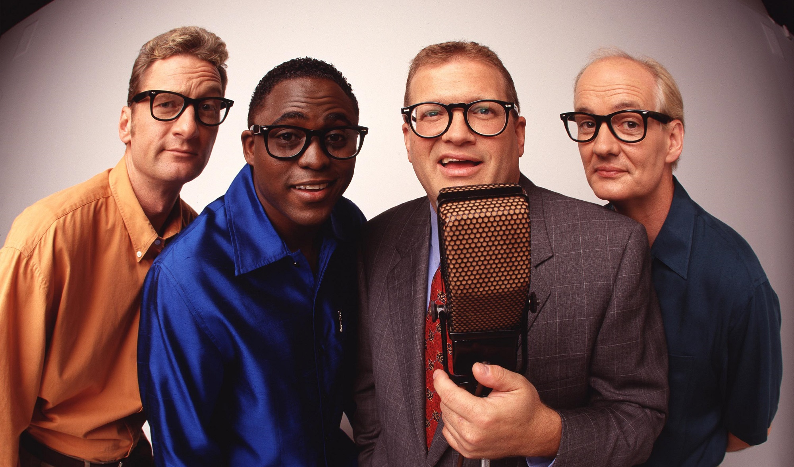
Notes:
Lets practice.

